Slide 1

Flow Architecture and Introduction to Redux
Lesson 11 – DONg, bui huu

Slide 2
Objectives
Discuss the features of the Flux architecture
Explain the Redux approach to implementing a variant of the Flow architecture
Install and Configure Redux in your application
Enable your React app to make use of Redux

Slide 3

The Flux Architecture

Slide 4
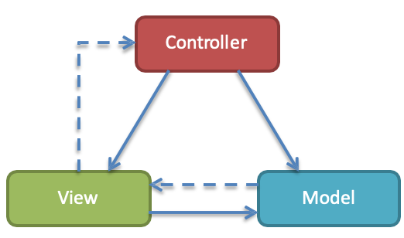
The Model-View-Controller (MVC) Framework

Slide 5
React and MVC
Initially React was viewed as the “V” in MVC
Facebook found issues with using the standard MVC architecture pattern
Discarded in favor of the Flux architecture
Problems with cascading updates, decentralized mutations, race conditions

Slide 6
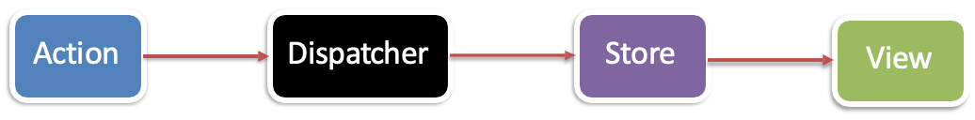
The Flux Architecture
Unidirectional Data Flow

Slide 7
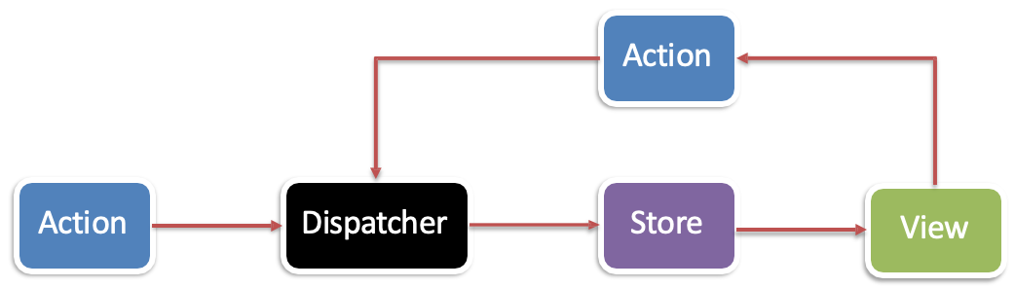
The Flux Architecture
New actions propagated through the system in response to user interactions

Slide 8
Redux

Slide 9
Introduction to Redux
What is Redux?
Predictable state container for JavaScript apps
Inspired by Flux, Elm, Immutable
Makes state mutations predictable

Slide 10
Main Principles of Redux
Single source of truth
Single state object tree within a single store
State is read-only (only getters, no setters)
Changes should only be done through actions
Changes are made with pure functions
Take previous state and action and return next state
No mutation of the previous state

Slide 11
What is Redux
Single store and single state tree enables powerful techniques:
Logging
API handling
Undo/redo
State persistence
“time-travel debugging”

Slide 12
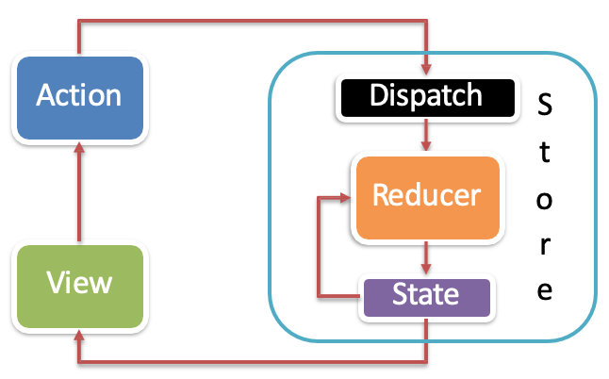
Redux Data Flow

Slide 13
Redux Toolkit

Slide 14
Redux Toolkit
Redux Toolkit
The Redux Toolkit package is intended to be the standard way to write Redux logic. It was originally created to help address three common concerns about Redux:
"Configuring a Redux store is too complicated"
"I have to add a lot of packages to get Redux to do anything useful"
"Redux requires too much boilerplate code“
Installation: npm install react-redux @reduxjs/toolkit

Slide 15
Redux Toolkit Concept
configureStore(): wraps createStore to provide simplified configuration options and good defaults.
createReducer(): that lets you supply a lookup table of action types to case reducer functions, rather than writing switch statements.
createAction(): generates an action creator function for the given action type string.
createSlice(): accepts an object of reducer functions, a slice name, and an initial state value, and automatically generates a slice reducer with corresponding action creators and action types.
createAsyncThunk: accepts an action type string and a function that returns a promise, and generates a thunk that dispatches pending/fulfilled/rejected action types based on that promise
createEntityAdapter: generates a set of reusable reducers and selectors to manage normalized data in the store
The createSelector utility from the Reselect library, re-exported for ease of use.

Slide 16
Redux Toolkit with React-Redux in React
Install Redux Toolkit and React-Redux
Create a Redux Store
Provide the Redux Store to React
Create a Redux State Slice
Add Slice Reducers to the Store
Use Redux State and Actions in React Components
More: https://redux-toolkit.js.org/tutorials/quick-start

Slide 17
Create a Redux store with configureStore
configureStore() accepts a reducer function as a named argument
configureStore() automatically sets up the store with good default settings

Slide 18
Provide the Redux store to the React application components
Put a React-Redux <Provider> component around your <App />
Pass the Redux store as <Provider store={store}>

Slide 19
Create a Redux "slice" reducer with createSlice
Call createSlice() with a string name, an initial state, and named reducer functions.
Export the generated slice reducer and action creators.

Slide 20
Use the React-Redux useSelector/useDispatch hooks in React components
Read data from the store with the useSelector hook.
Get the dispatch function with the useDispatch hook, and dispatch actions as needed.

Slide 21
Exercise 16: Introduction to Redux
Install and configure Redux within your application.
Configure your React application to make use of Redux Toolkit.

Slide 22
Summary
Discuss the features of the Flux architecture
Explain the Redux approach to implementing a variant of the Flow architecture
Install and Configure Redux Toolkit in your application
Enable your React app to make use of Redux

